Slide 2
Imaging

Slide 3
Imaging
Imaging Section
Contains diagnostic radiology procedures
Nuclear medicine is a separate section
Radiation Oncology is a separate section
Interventional Radiology
The intervention procedure is coded in the Medical and Surgical section
Root type (Character 3)
Plain Radiography
Fluoroscopy
CT Scan
MRI
Ultrasound

Slide 4
Imaging
Plain Radiography
Planar display of an image developed from the capture of external ionizing radiation on photographic or photoconductive plate
Fluoroscopy
Single plane or bi-plane real time display of an image developed from the capture of external ionizing radiation on a fluorescent screen. The image may also be stored by either digital or analog means
Computerized Tomography (CT Scan)
Computer-reformatted digital display of multiplanar images developed from the capture of multiple exposures of external ionizing radiation
Magnetic Resonance Imaging (MRI)
Computer-reformatted digital display of multiplanar images developed from the capture of radio-frequency signals emitted by nuclei in a body site excited within a magnetic field

Slide 5
Imaging
Magnetic Resonance Imaging (MRI)
Computer-reformatted digital display of multiplanar images developed from the capture of radio-frequency signals emitted by nuclei in a body site excited within a magnetic field
Contrast Material (Character 5)
Contrast is differentiated by the concentration of the contrast material (e.g., high or low osmolar)
Qualifier (Character 6)
Specifies an imaging procedure without contrast followed by contrast

Slide 6
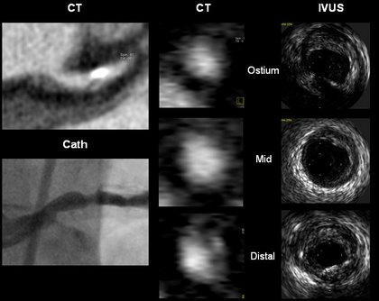
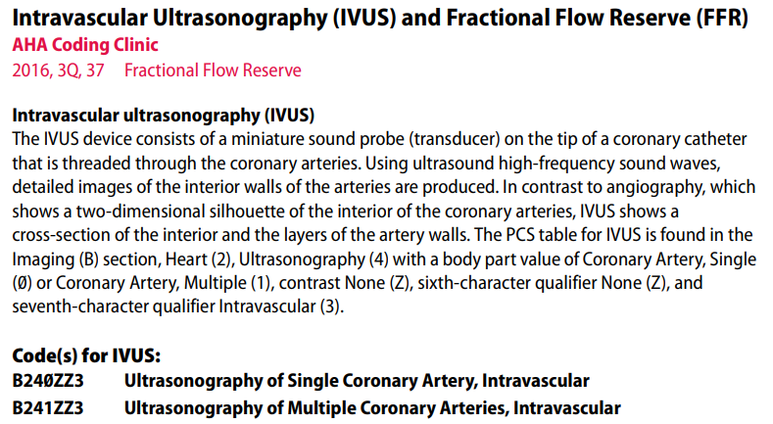
Coding clinic
Central venous catheter placement with imaging guidance combines fluoroscopy and ultrasound guidance with catheter insertion in order to accurately align the tip of the catheter in the correct position. In the inpatient setting, coding radiologic guidance is optional. For facilities that wish to collect this information, fluoroscopic guidance is classified in ICD-10-PCS at table B51 with the qualifier value "Guidance."

Slide 7
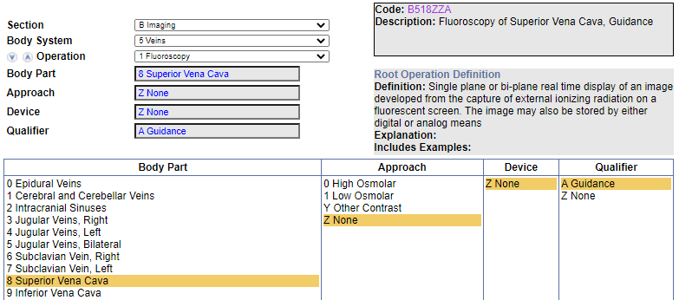
Clinical Example
A central venous catheter is inserted for renal dialysis under fluoroscopic guidance without contrast with the tip ending in the superior vena cava. In ICD-10-PCS, table B21 does not provide a "No Contrast" value. What is the correct ICD-10- PCS value for fluoroscopic guidance?
Coding Navigation:

Slide 8
Clinical Example
A patient diagnosed with mitral valve stenosis underwent percutaneous balloon valvuloplasty, right and left heart catheterization (pressure measurements, oximetry sampling, and cardiac output assessment), and left ventriculogram using low osmolar contrast. We reported a code for the balloon valvuloplasty. Would it be appropriate to apply the multiple procedure guideline B3.2c and assign separate codes for the right and left heart catheterization as well as the left ventriculogram?
In addition to reporting a code for the balloon valvuloplasty, assign the following codes:
4A023N8 Measurement of cardiac sampling and pressure, bilateral, percutaneous approach, for the right and left heart catheterization
B2151ZZ Fluoroscopy of left heart using low osmolar contrast, for the left ventriculogram

